Slide 1
History 439
Introduction

Slide 2
Catholic vocabulary
God, Trinity: Father, Son, Holy Spirit angels, saints, Blessed Virgin Mary heaven, purgatory, hell church triumphant, church suffering, church militant

Slide 3
Catholic vocabulary
7 sacraments
baptism Eucharist penance confirmation Holy Orders marriage extreme unction
Mass, transubstantiation
sacramentals

Slide 4
Catholic vocabulary
pilgrimage, shrine, relic
cult of the saints: canonization
seasons of the liturgical year:
Advent
Christmas
Lent
Easter

Slide 5
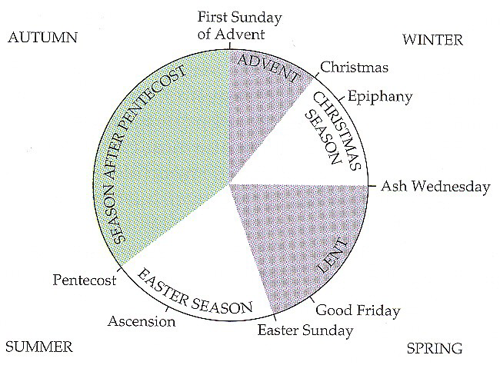

Slide 6
Catholic vocabulary
Hierarchy
pope (Bishop of Rome, elected by cardinals in conclave)
bishops
priests
deacons
subdeacons

Slide 7
Catholic vocabulary
bishop (ordinary):
see / diocese, ecclesiastical province
metropolitan, suffragan, coadjutor, patriarch, primate, primacy, archdeacon
cathedral
mitre, crosier / crozier
pluralism, absenteeism, simony

Slide 8
Catholic vocabulary
clergy: secular (diocesan) or regular (regula = rule) --(cathedral) canon, benefice --celibacy, concubinage
mendicants: Order of Friars Minor (Franciscans), Order of Preachers (Dominicans), prior
monasticism: Rule of Benedict, Benedictines, Cistercians, Carthusians, abbot, monk; convents: nuns
in commendam, commendatory abbot
pastoral care, canon law

Slide 9
Catholic vocabulary
Roman Curia: Apostolic See (Holy See)
Pope – College of Cardinals; Consistory
Cardinal Vicar, Cardinal Nephew, Cardinal Secretary of State
legates, nuncios
sede vacante = vacant see
Curial Offices: Apostolic Chancery, Datary, Apostolic Camera, Secretariat of State
Tribunals: Penitentiary, Rota, Signatura

Slide 10
Catholic vocabulary
Roman Congregations:
Holy Office Sacred Consistorial Congregation: Bishops Oriental Churches Discipline of the Sacraments Council Religious Propaganda Fide Rites Ceremonies Roman University Index, Index of Prohibited Books.

Slide 11
History 439
Course objective:
What was Catholicism in early modern Europe?
What are names that identify Catholicism?

Slide 12
History 439
The significance of the Council of Trent
Midterm question:
Was the Council of Trent the defining event of early modern Catholicism?

